Slide 1
Spotify Wake Word Detection Project
Roma Shusterman, Zan Butt, Evgeny Mun

Slide 2
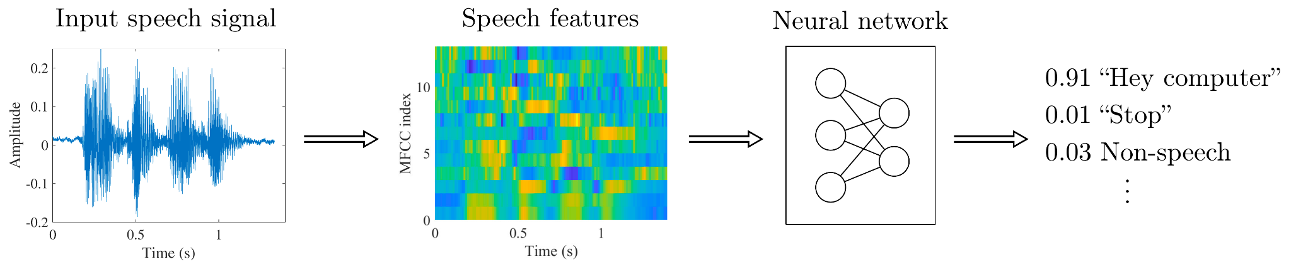
Background and Significance of Project
Wake word detection is a critical part of the design of the system where AI is always listening to the incoming command before waking up to full power. The goal is to correctly identify the phrase, preserve power on device, and avoid possible privacy issues.
The overall structure of keyword-spotting algorithms is illustrated below (adapted from https://wiki.aalto.fi/display/ITSP/Wake-word+and+keyword+spotting).
Company
Adapted from Yundong Zhang, Naveen Suda, Liangzhen Lai and Vikas Chandra, "Hello Edge: Keyword Spotting on Microcontrollers"

Slide 3
Explanation of Data sets
We used MCV corpus 8 en https://commonvoice.mozilla.org/en datasets - 72Gb, 80K voices, MP3 data as a source for positive (hey, fourth & brain) and negative wav files.
The data has MP3 files in the clips folder and .tsv files with transcriptions of the audio. There are train, test, and validation audio sets in the MCV.
We used MFA to create timestamps for each of the MP3 files. The timestamps are needed to extract the wake words from the audio files later.
To address the imbalanced data we used google cloud API to generate additional positive wav files. Then we recorded two hundred short audio files with background noise.
The final positive data had about 6K audio files and 4K negative data.
Company

Slide 4
Explanation of Processes: Data processing
Created dataloader class to handle batch data processing on GPU
Converted wave and frequency data into an array of numbers by applying MEL Spectogram
Make audio length similar between positive and negative samples. Just like images are converted to an array we converted sound into an array of equal sizes.
Finally added the noise. MCV audio is pretty clean and doesn't have much background noise. In a real-life situation, there is always background noise.
Company

Slide 5
Explanation of Processes: Modeling approach
Used CNN in pytorch to predict the label for each of the wake words instead of the complete phrase instream.
Design # 1: 4 conv blocks / flatten / linear / softmax => Didn’t work
Design # 2 was borrowed from https://github.com/shlbatra/TriggerWakeWordDetection
Overall we achieved a good accuracy and F1 results with this architecture but ran into some issues during a real-life test.
Once the model was built we used HTML, JavaScript, Uvicorn and FastAPI deployed on AWS EC2 instance to test wake word detection.
Company

Slide 6
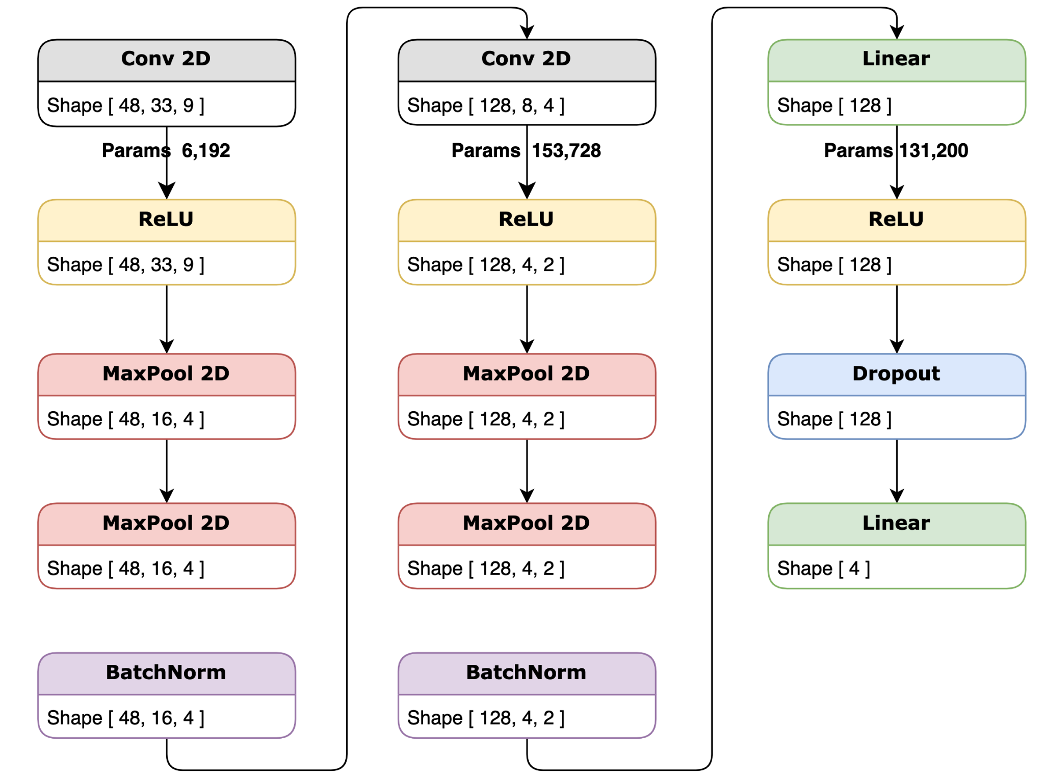
Explanation of Processes: CNN Architecture
Company

Slide 7
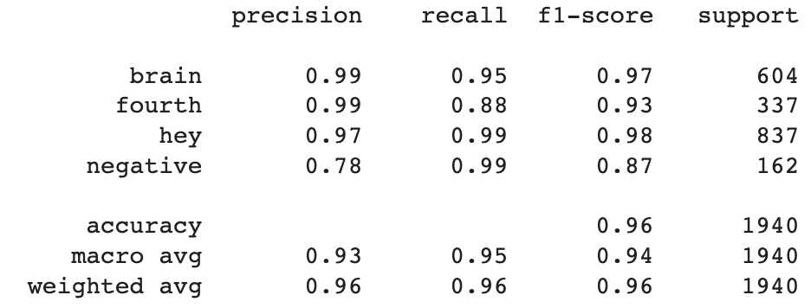
Explanation of Outcomes
We trained the model for 20 epochs while tracking the cross entropy loss.
Running the model on test data produced an Accuracy of 0.96 with an F1 score above 0.93 for wake words.

Slide 8
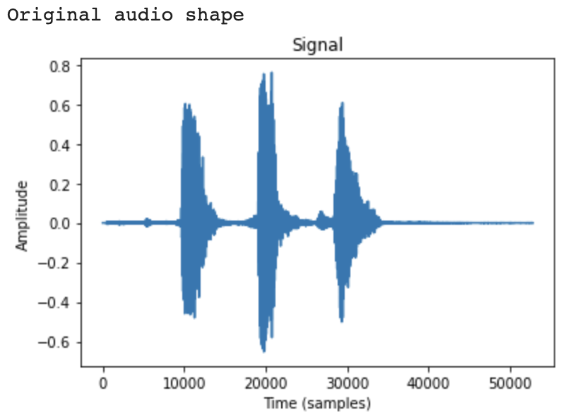
Explanation of Outcomes
However, as mentioned before we ran into some challenges while testing live voice detection.
Instead of using stream detection, we split the recorded audio into chunks of wav file based on the silence gap and the amplitude of the frequency.
Overall the results are still encouraging and indicate that CNN can detect voice phrases.
Here is the shape of one of the test audios with three words:

Slide 9
System Design and Ethical Considerations
In this project, we focused more on designing a wake word API for testing and proving purposes. Thus our design doesn’t address possible issues with recording the audio before detecting the wake word phrase.
As one can imagine recording the audio can lead to privacy and compliance concerns.
In future improvements, we will move from recording audio to detecting the wake word in the stream.

Slide 10
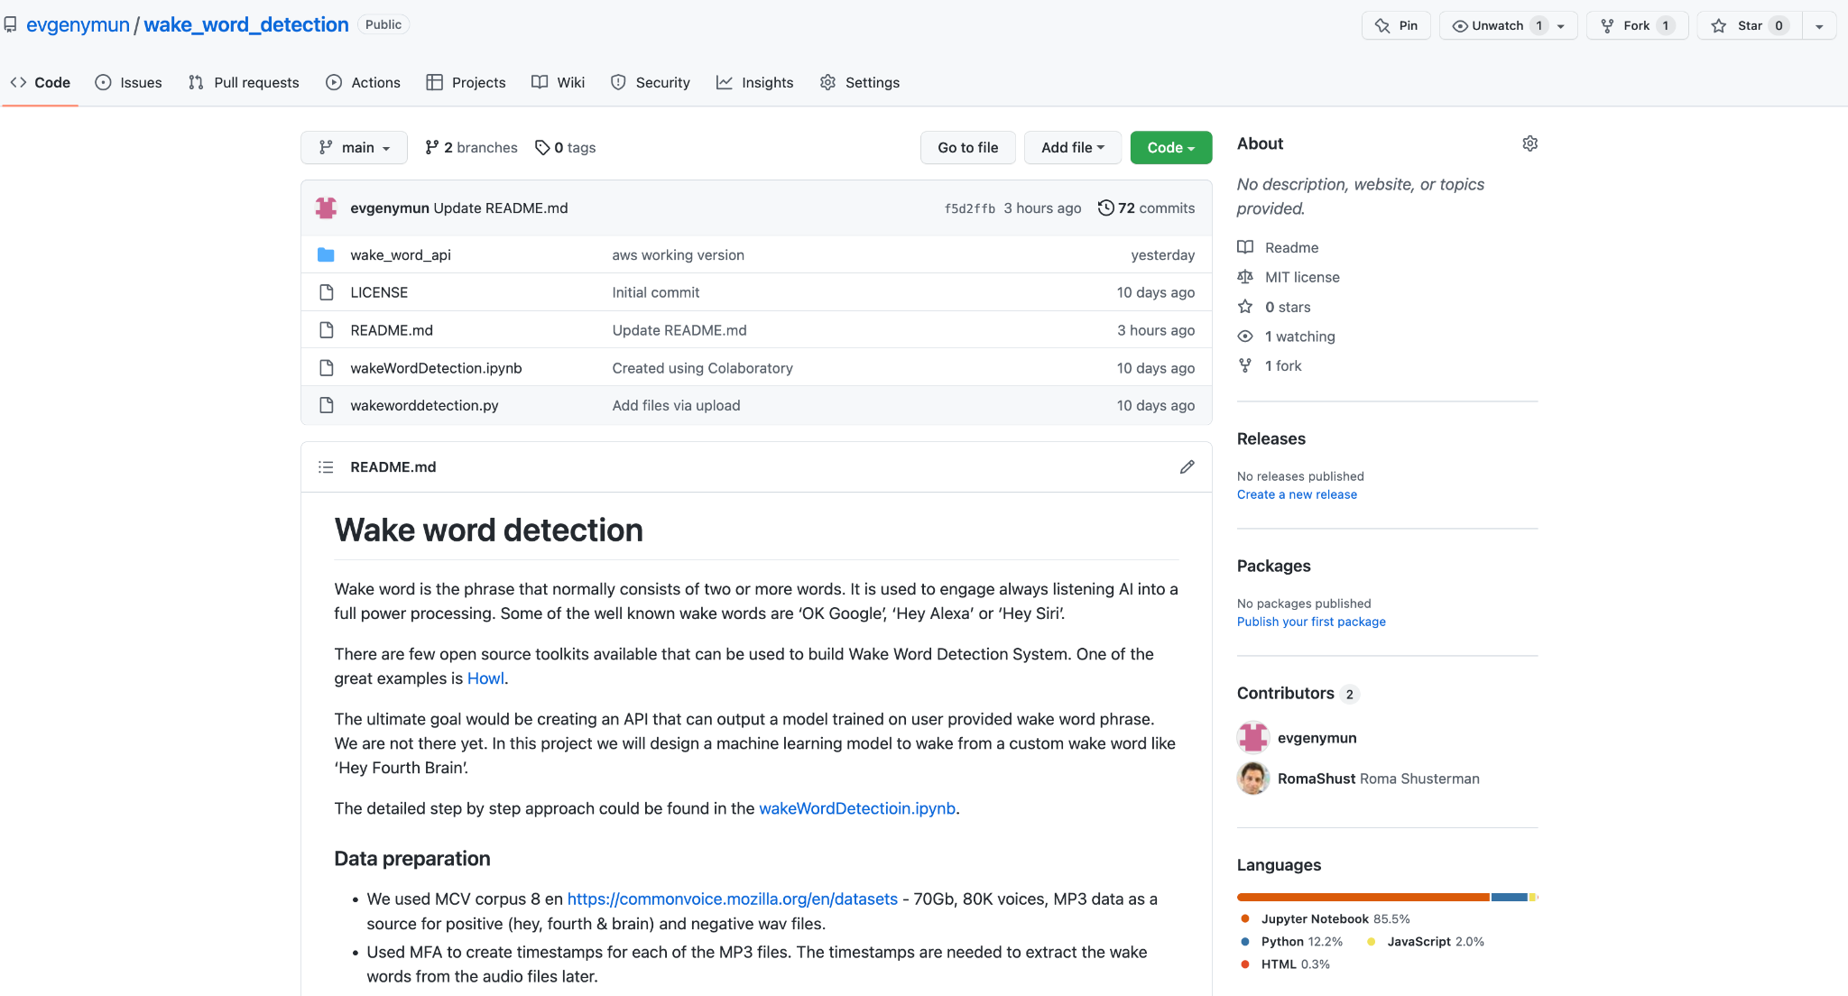
Github repo
https://github.com/evgenymun/wake_word_detection

